Slide 1
PART II – Arduino
Compiled and Presented by:
N V A L Vara Prasad
nukala.ece2021@vietsp.com

Slide 2
Introduction to arduino

Slide 3
Arduino
Arduino is the go-to gear for artists, hobbyists, students, and anyone with a gadgetry dream.
Arduino rose out of another formidable challenge: how to teach students to create electronics, fast.
With Arduino, you can control almost everything around you be it simple LED or giant Robots.

Slide 4
Arduino
Basically Arduino is Microcontroller.
Microcontroller is microprocessor with memory, RAM and some other peripheral connected with it.
The Arduino Uno is a microcontroller board based on the ATmega328 . The ATmega328 has Flash memory of 32 KB (with 0.5 KB used for the bootloader). It also has 2 KB of SRAM and 1 KB of EEPROM
Notes:
Flash- Where program is stored.
SRAM-Static Random Access Memory ( sketch creates and manipulates variables when it runs )
EEPROM- Electrically Erasable Programmable Read-Only Memory ( memory whose values are kept when the board is turned off )

Slide 5
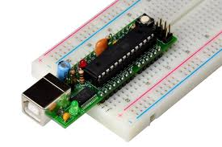
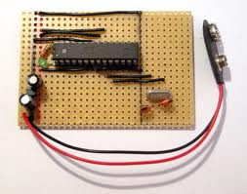
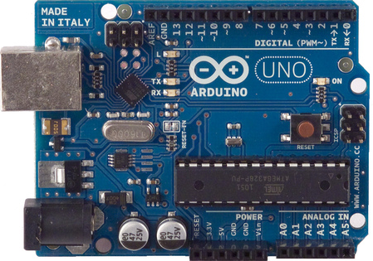
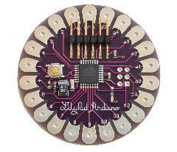
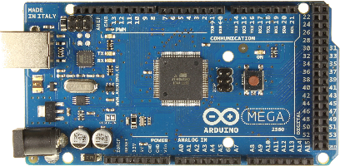
Different types of Arduino
Boarduino Kit
Arduino LilyPad
DIY Arduino
Arduino Uno
Arduino Mega 2560

Slide 6
Arduino uno
What does it have?
14 Digital In/Out pins (6 can be used as PWM)
6 Analog Inputs
A USB Connection
A Power Jack
Reset Button
On-board LED
SCL/SDA pins (Serial Clock/ Serial Data pins)
In short, it contains everything needed to support the microcontroller; simply connect it to a computer with a USB cable or power it with a AC-to-DC adapter or battery to get started.

Slide 7
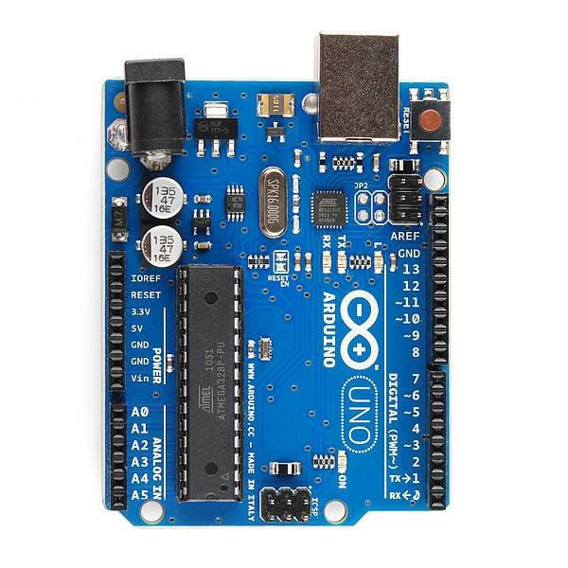
USB
(to Computer)
PWR IN
RESET
SCL\SDA
(I2C Bus)
POWER
5V / 3.3V / GND
Digital I\O
PWM(3, 5, 6, 9, 10, 11)
Analog INPUTS

Slide 8
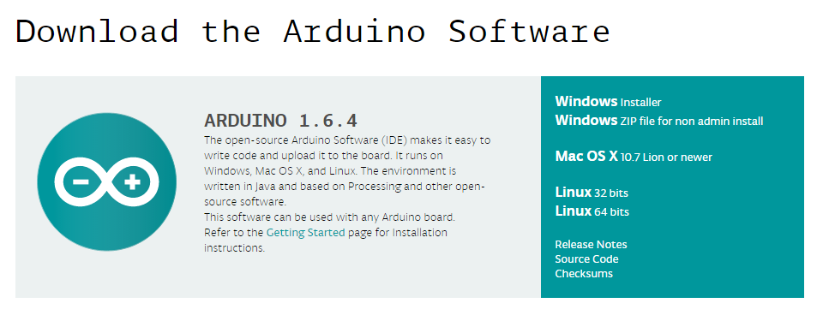
How to code in arduino
You need to download Arduino IDE (Integrated Development Environment).
Arduino IDE is available for all Mac, Windows.and Linux.

Slide 9
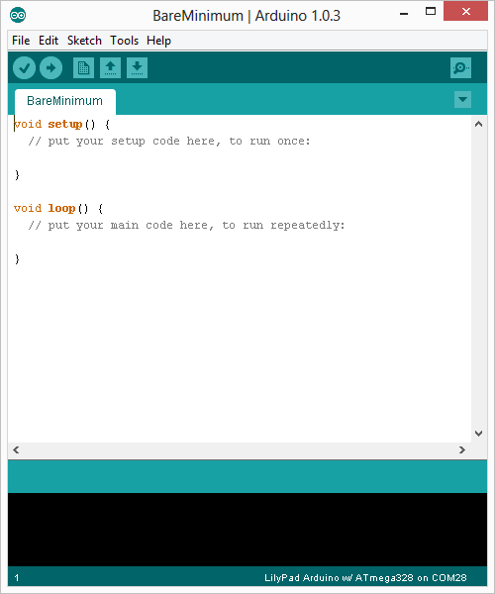
How to code in arduino
Once you have downloaded and installed/extracted the folder, you can directly run Arduino.exe, which will take you to its IDE.
The IDE will look like the shown screenshot.
error & status messages

Slide 10
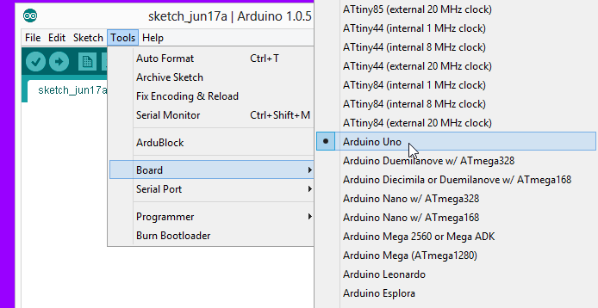
Program your arduino
Before you start programming, double check that correct board is selected under Tools → Board.
Now, you can start playing with Arduino.

Slide 11
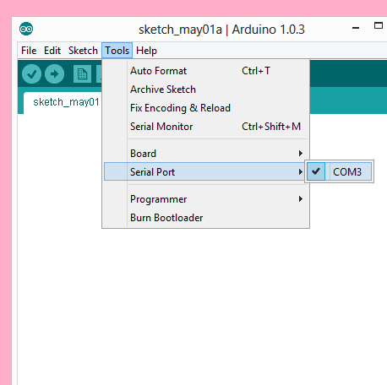
Program your arduino
The Arduino Uno can be programmed with the Arduino software. Select "Arduino Uno from the Tools > Board menu (according to the microcontroller on your board).
All the peripheral connected with Computers are using Serial Port.
You can check port for Arduino Uno in Device Manger.

Slide 12
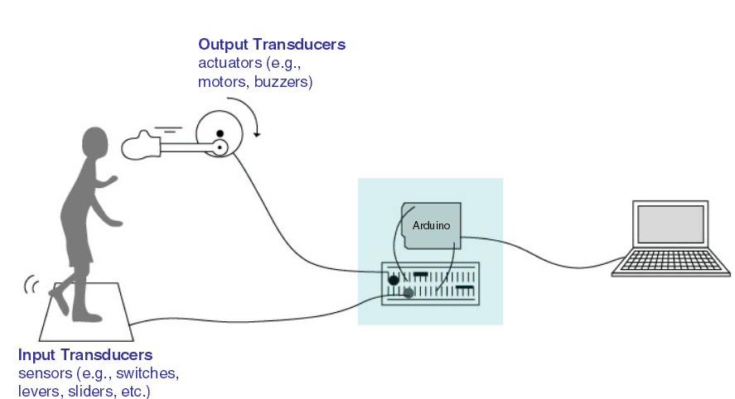
Input vs output

Slide 13
6 Major concepts
digitalWrite()
analogWrite()
digitalRead()
If (statements) / Boolean
analogRead
Serial Communication

Slide 14
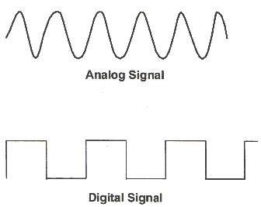
Analog vs digital
Microcontrollers are digital devices – ON or OFF. Also called – discrete.
Analog signals are anything that can be a full range of values.
5 V
5 V
0 V
0 V

Slide 15
Analog vs digital
Analog Sensors
Digital Sensors
Digital sensors are more straight forward than Analog.
No matter what the sensor there are only two settings: On and Off
Example, Push button, Switch
Sensors | Variables
Mic | soundVolume
Photoresistor | lightLevel
Potentiometer | dialPosition
Temp Sensor | temperature
Flex Sensor | bend
Accelerometer | tilt/acceleration

Slide 16
Serial communication
“Serial” because data is broken into bits, each sent one after another in a single wire.
Compiling turns your program into binary data (ones and zeros)
Uploading sends the bits through USB cable to the Arduino
The two LEDs near the USB connector blink when data is transmitted.
RX blinks when the Arduino is receiving data.
TX blinks when the Arduino is transmitting data

Slide 17
Let’s start coding

Slide 18
Project #1 led blink
digitalWrite()

Slide 19
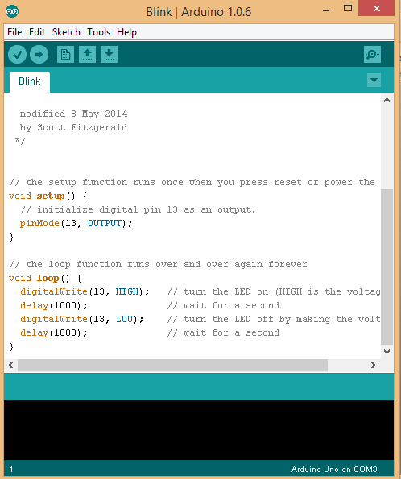
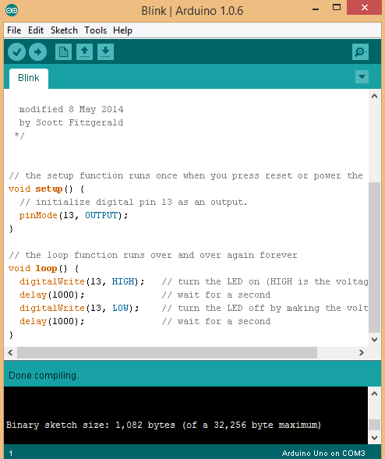
Upload
Compile
Status Message

Slide 20
Thank you

